Slide 1

Hybrid App Mobile Dev Course
Wifi : fstmkuis/fstmkuis
SLIDES/NOTES
Bit.ly/ionickerul

Slide 2


Slide 3
COURSE OVERVIEW

Slide 4
DAY 1: Introduction to Ionic Framework
DAY 1: Installing Ionic Framework & its tools
DAY 1: HTML, Angular, TypeScript & CSS
DAY 1: Start A Project, Generating Pages & Navigating to it, Run A Project

Slide 5
DAY 2: Executing Functions in TypeScript Programming Navigation in Ionic
DAY 2: Using Angular Commands Using For Loop and *ngFor Using If Else and *ngIF Using (click) Using [(ngModel)]
DAY 2: Using Services, and Firebase Services
DAY 2: Using Ionic Native Plugins & Firebase CRUD

Slide 6
DAY 3: Resources and Asset preparation for -Progressive Web App -Android Application -iOS Application (for Mac)
DAY 3: Installing & Setting Up Android SDK for PC & Mac Installing & Setting Up iOS for Mac
DAY 3: Publishing you mobile application

Slide 7
OVERVIEW
TO IONIC FRAMEWORK

Slide 8
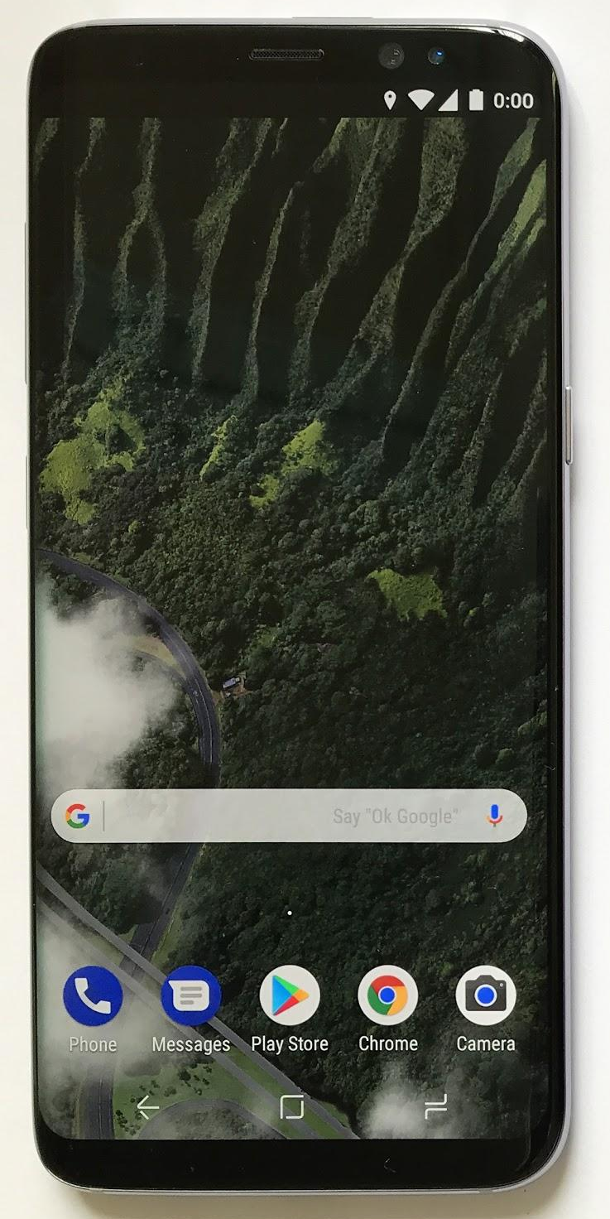
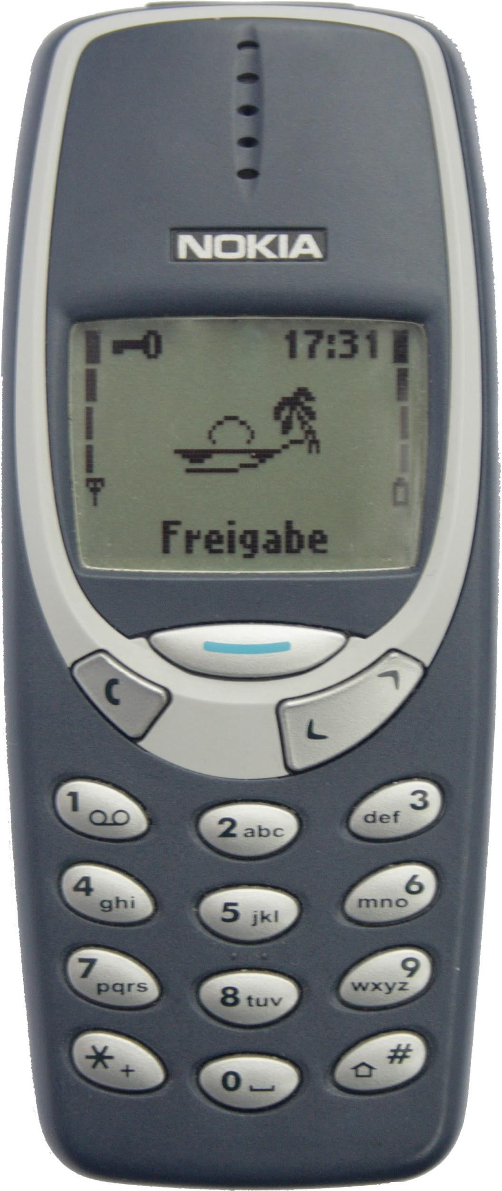
Apps in our life
Mid 1990s - Mid 2010s
Telephone
SMS
Snake
Today

Slide 9
Apps in our life
A mini computer in our pocket
Filled with apps
NOW

Slide 10

What is Ionic?
Ionic Framework is an open source UI toolkit for building performant, high-quality mobile and desktop apps using web technologies (HTML, CSS, and JavaScript).

Slide 11
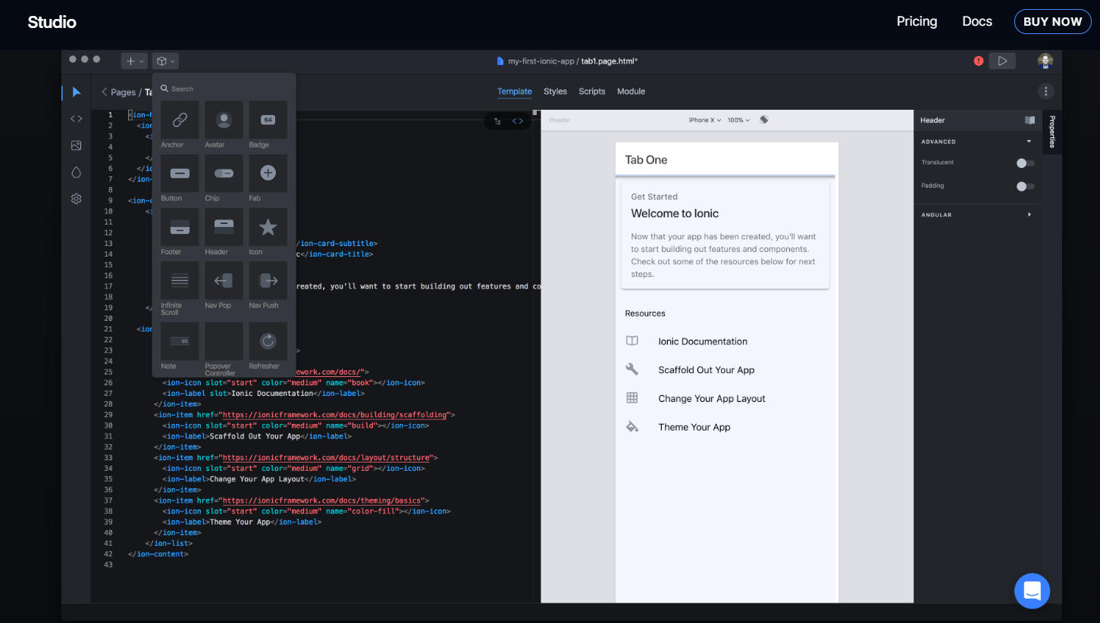
Ionic Studio

Slide 12
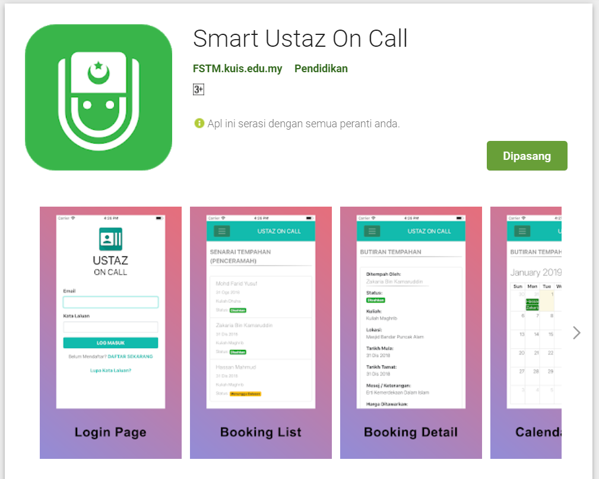
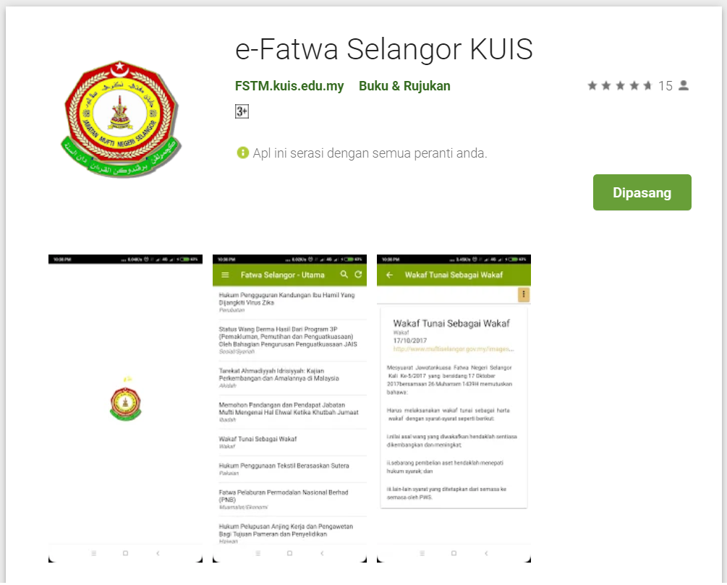
Available apps

Slide 13
IOS & Android Software Development
In a nutshell

Slide 14
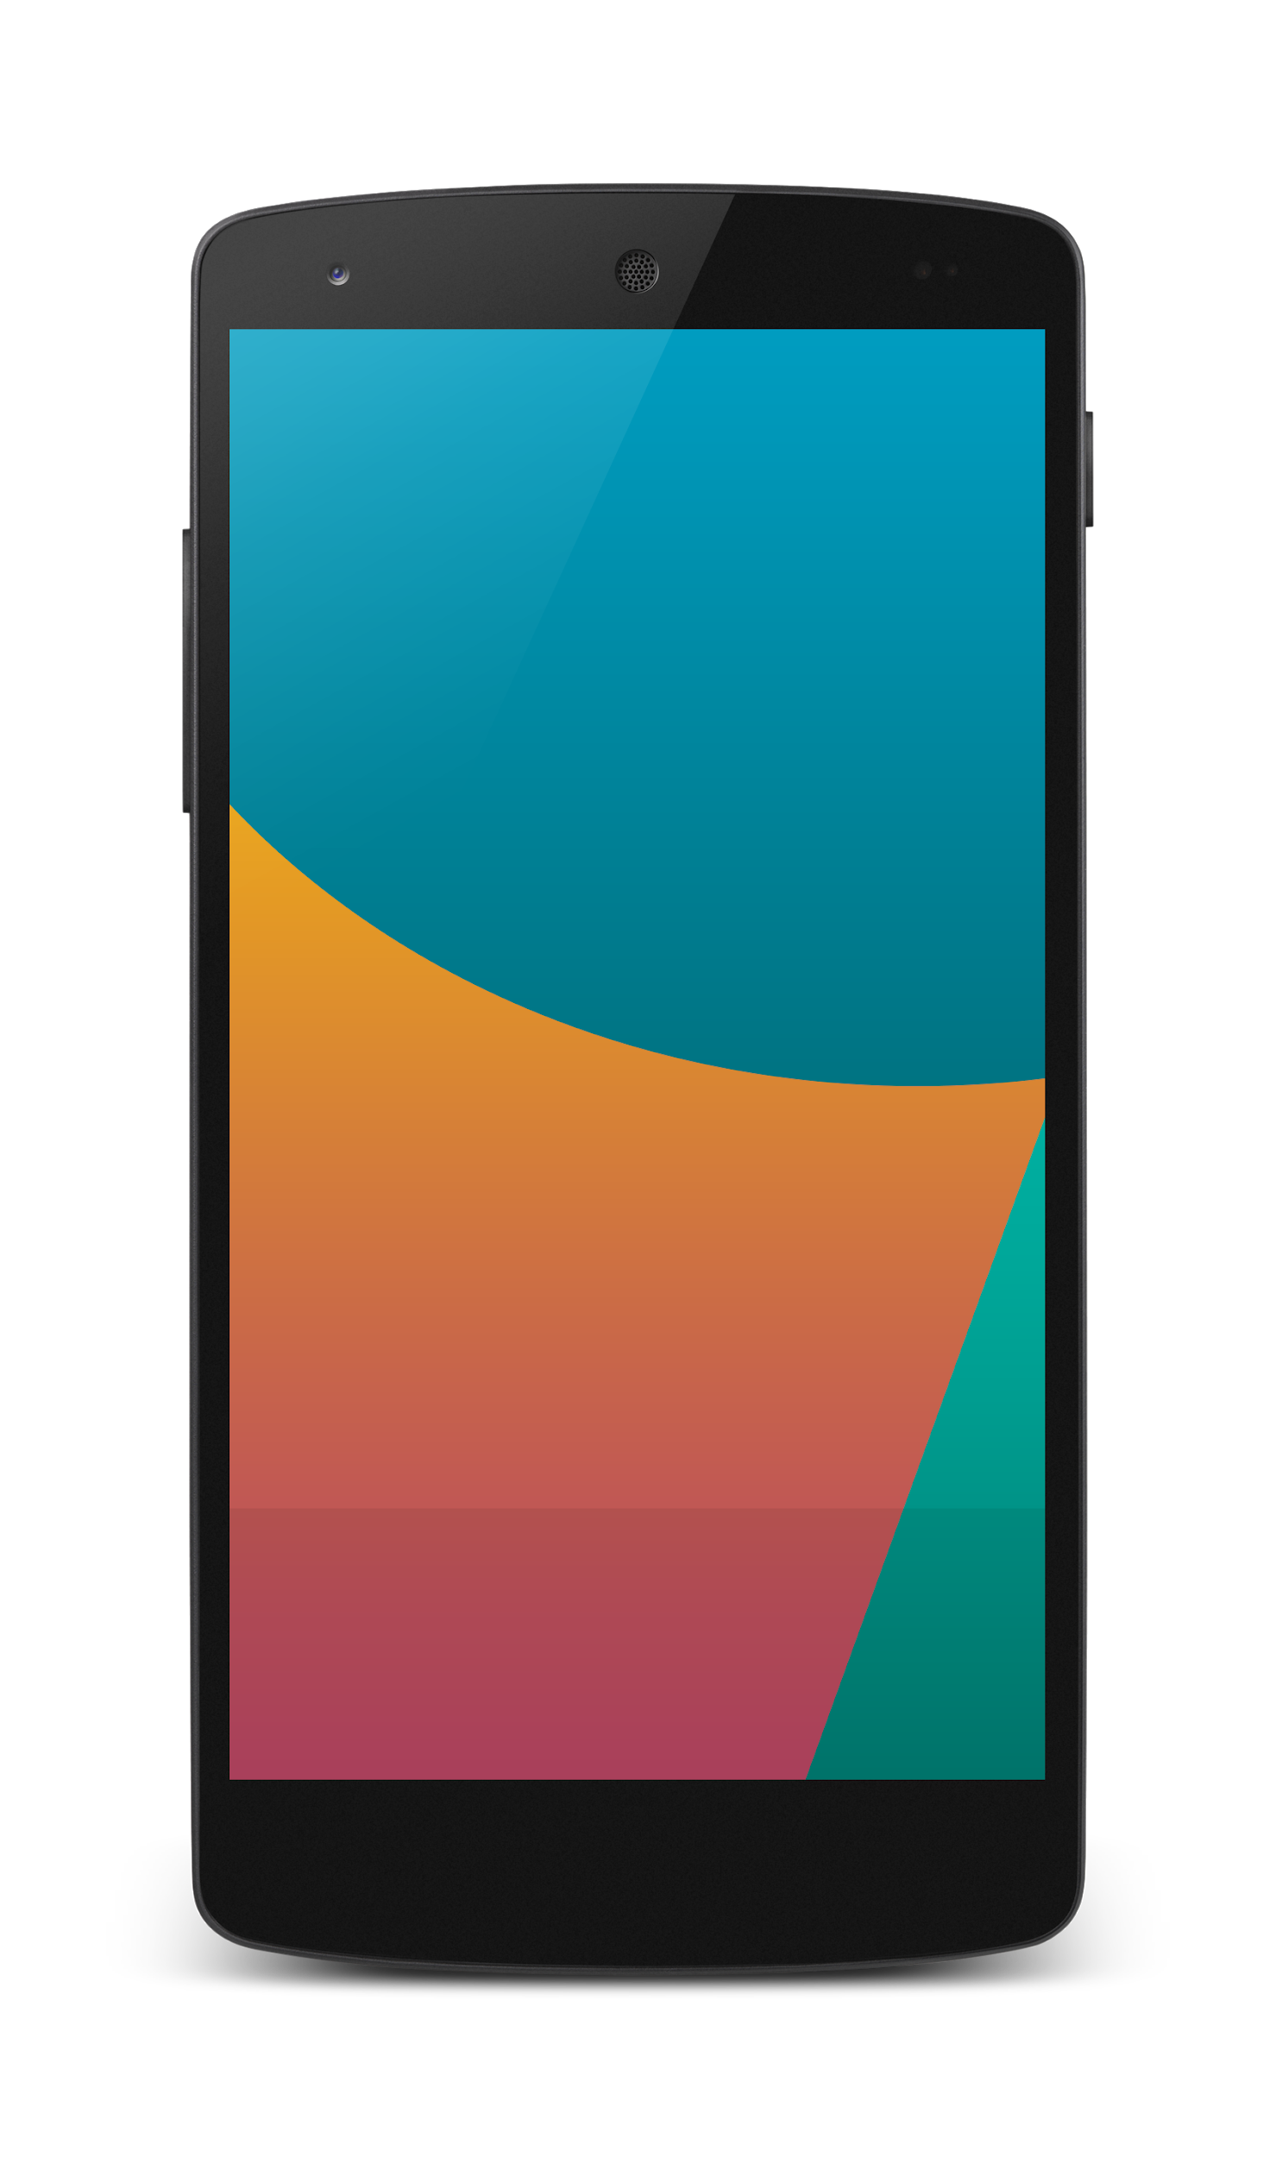


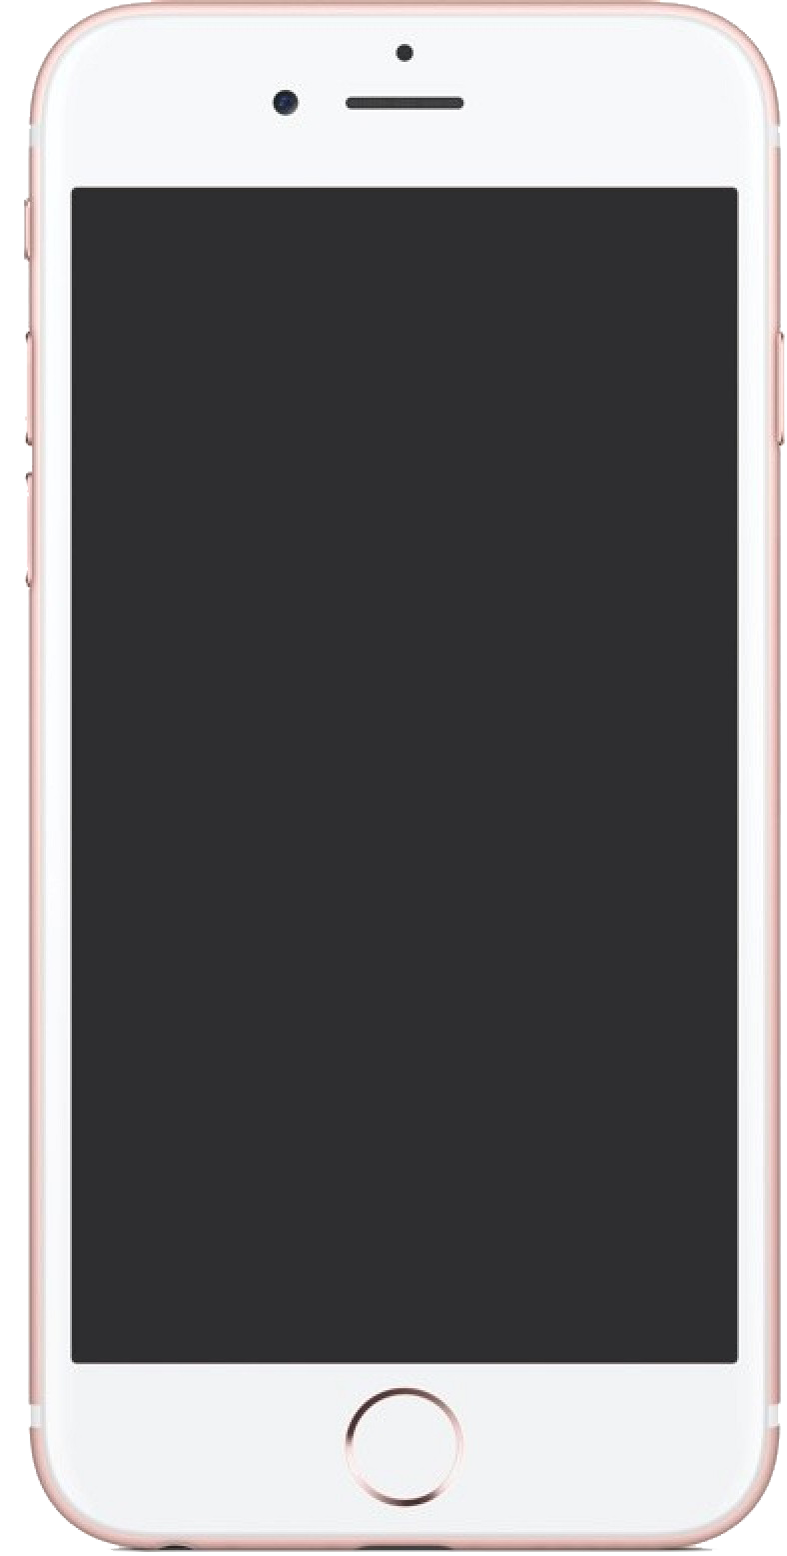

Android Studio
(Java & Kotlin)
Android Device
NATIVE - 2 X WORK
XCode (Swift & Objective C)
iPhone/iPad

Slide 15
1 x WORK
Compile with Android SDK
Android Device
Cordova/
Phonegap
Hybrid
Still very messy
No standard framework
Xcode Project
iPhone/iPad

Slide 16

1 x WORK
Compile with Android SDK
Android Device
Cordova
Framework
Hybrid
XCode Project
iPhone/iPad

Slide 17
Cordova
Framework
Hybrid
WEB LAYER
NATIVE APP

Slide 18
1 x WORK
Build Progressive Web Apps
Android Device
Build Progressive Web Apps
Cordova
Framework
Hybrid
iPhone/iPad

Slide 19

https://ionicframework.com/pwa

Slide 20


1 x WORK
Android Studio
Android Device
+
XCode
iPhone/iPad

Slide 21
https://capacitor.ionicframework.com/

Slide 22



WHY IONIC?
Framework specifically to develop apps
Multiple platforms-Android, IOS, Windows, Amazon etc
Apps development using HTML & Typescript (subset of Javascript)
Plugins (camera, thumbprint, bluetooth, printer etc etc etc)

Slide 23
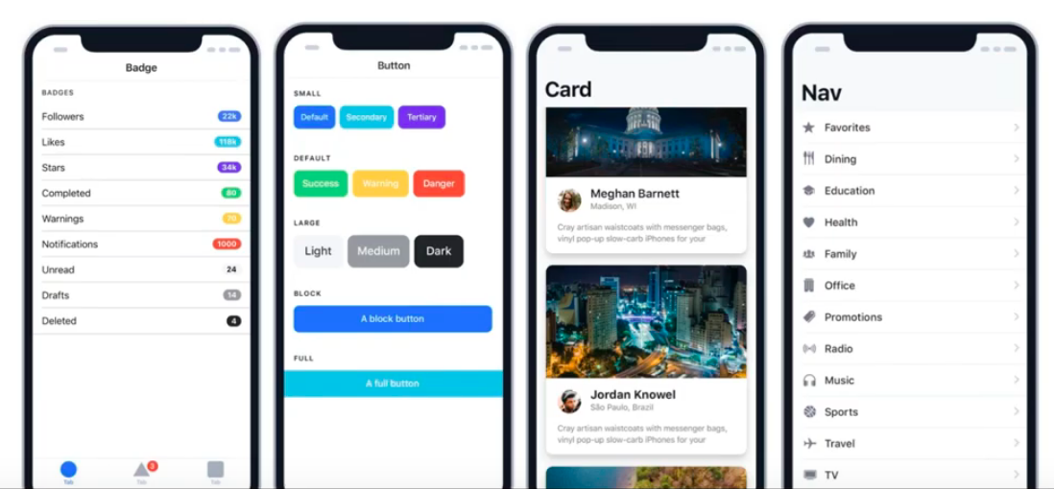
WHY IONIC?
Large COMMUNITY for support
Pre built gestures & animation
100+ UI Components
Everything is OPEN SOURCE
Built with Ionic

Slide 24
What do you need?

Slide 25
What do you need?
To run IONIC:
Node Package Manager (NPM)
Ionic Cordova Framework
Android SDK or Xcode- can be done later
To develop:
VSCode OR any other IDE (with Typescript Plugin)
Google Chrome Web Browser
Register a Gitlab Account
Ionic DevApp

Slide 26
Install NodeJS
node -v
npm -v

Slide 27
2. From command terminal run:
npm install -g ionic cordova

Slide 28
Now, let’s install the tools

Slide 29
Install VSCode/sublime
NodeJS
Tutorial is here bit.ly/ionickerul
Install Google Chrome Browser
(If you don’t have, you should)

Slide 30
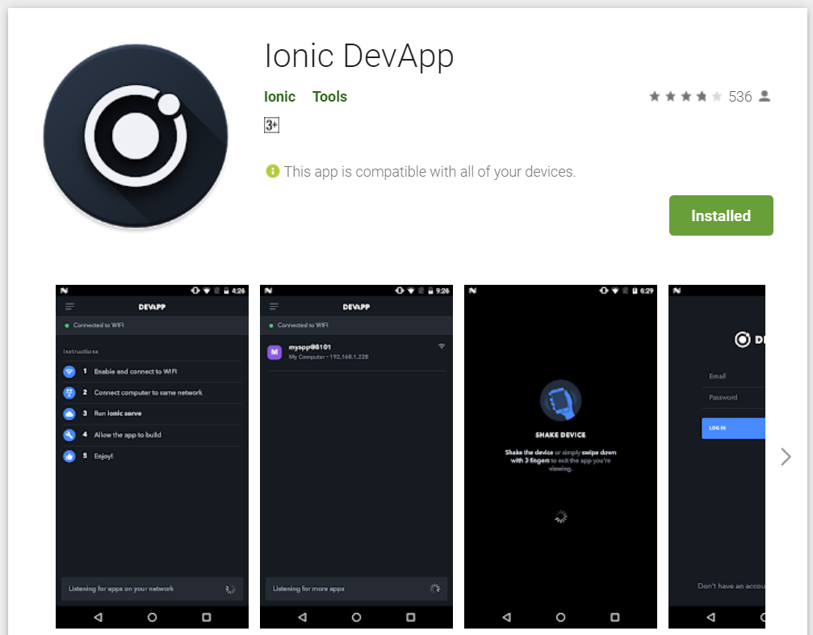
Testing : ionic serve --devapp

Slide 31
Before we start coding, some basic stuff...

Slide 32
-HTML?
-CSS ?
-TypeScript ?

Slide 33
WHAT YOU JUST DID?
VIEW
-HTML files in the pages folder
-2 already pre built
CONTROLLER
-TS files in the pages folder
-2 already pre built
APP FOLDER
app.module.ts
app.component.ts
Whatever we do, this 2 files VIP
MODEL
-service files
SEES:
button
USES:
helloWorld()
function
USER
This depends on each other, if one is broken, your app will not work

Slide 34
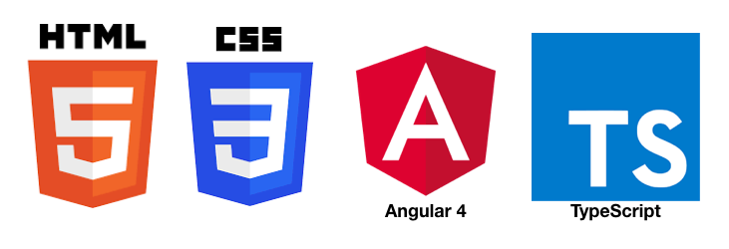
HTML
-Hyper Text Mark Up Language (HTML)
-Used to display the interface
-Write in tags,
-Example- <strong>Hello</strong> → Hello
-Ionic has its own built in tags
<ion-list></ion-list>
<ion-item></ion-item>
<ion-grid></ion-grid>
-HTML in Ionic is “AngularJS Flavoured”
-Have to use Angular Syntax for data and clicks
-Example- (click), *ngFor etc

Slide 35
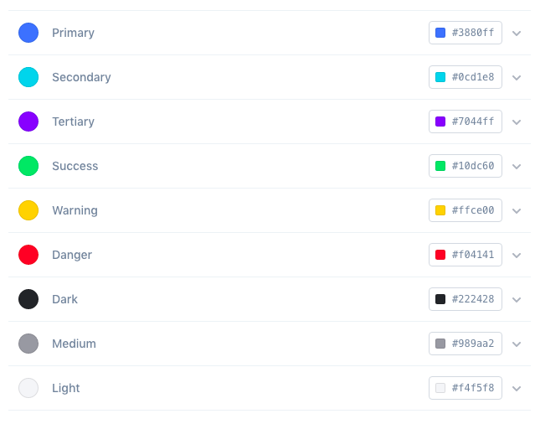
CSS or SCSS
-Cascading Style Sheets (CSS)
-Used for styling, very straightforward
-Each generated Ionic page comes with built in own CSS
-Can assist in ‘theming’ the app
-Ionic has standard built in colours
-Primary, Secondary, Danger, Light & Dark
Built in colours that can be added/edited

Slide 36
TypeScript
-A subset of Javascript
-Part of ECMA6 standard
-The ‘brains’ behind your app
-Used for processing & handling data
Example- calculation, accessing DB etc
-Ionic has standard built in to its TS:
NavController, ModalController etc
VARIABLES NEXT SLIDE

Slide 37
TypeScript
Data types:
Var
can be numbers or words
String
can only be words
Objects
{name: “Mickey”}
Array
can be a collection of Var, Strings or Objects
What is a variable?
A variable, by definition, is “a named space in the memory” that stores values
In other words, it acts as a container for values in a program

Slide 38
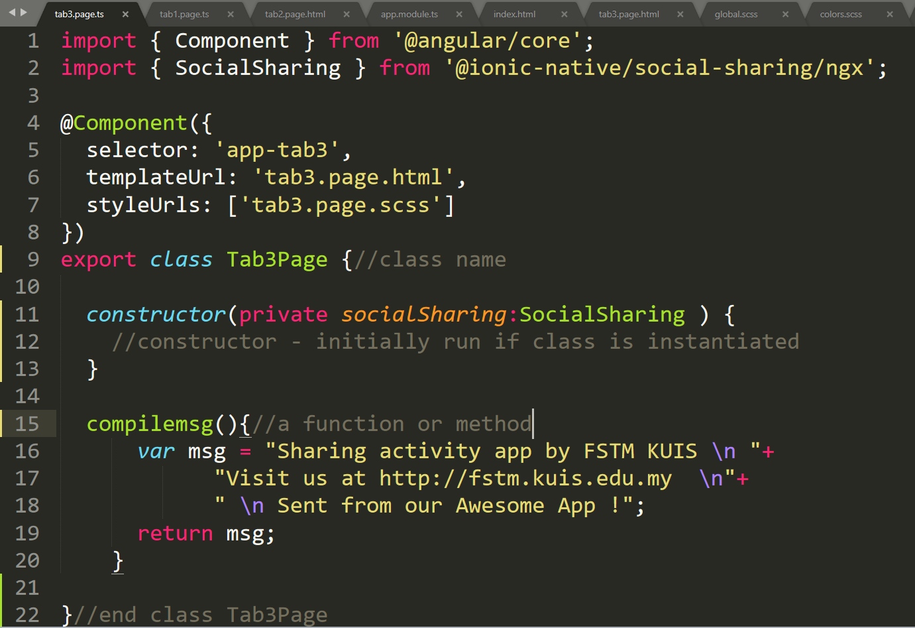
Class Function

Slide 39
Let’s START BUILDING OUR FIRST APP...

Slide 40
Building a
Hello World app

Slide 41
1. Start a project
ionic start appfstm tabs

Slide 42
2. CD into Directory & Run the project
ionic serve
ionic serve --devapp

Slide 43
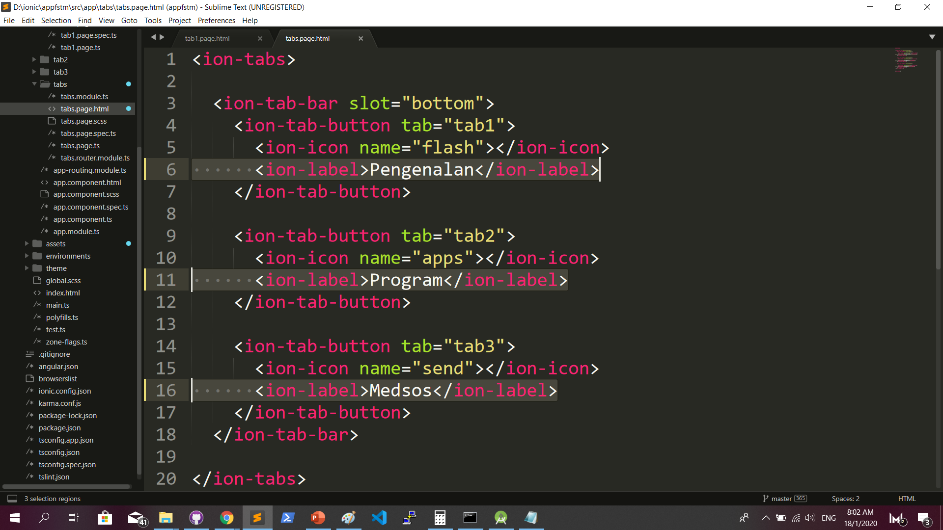
Some interface cosmetics: src/app/tabs/tabs.page.html

Slide 44
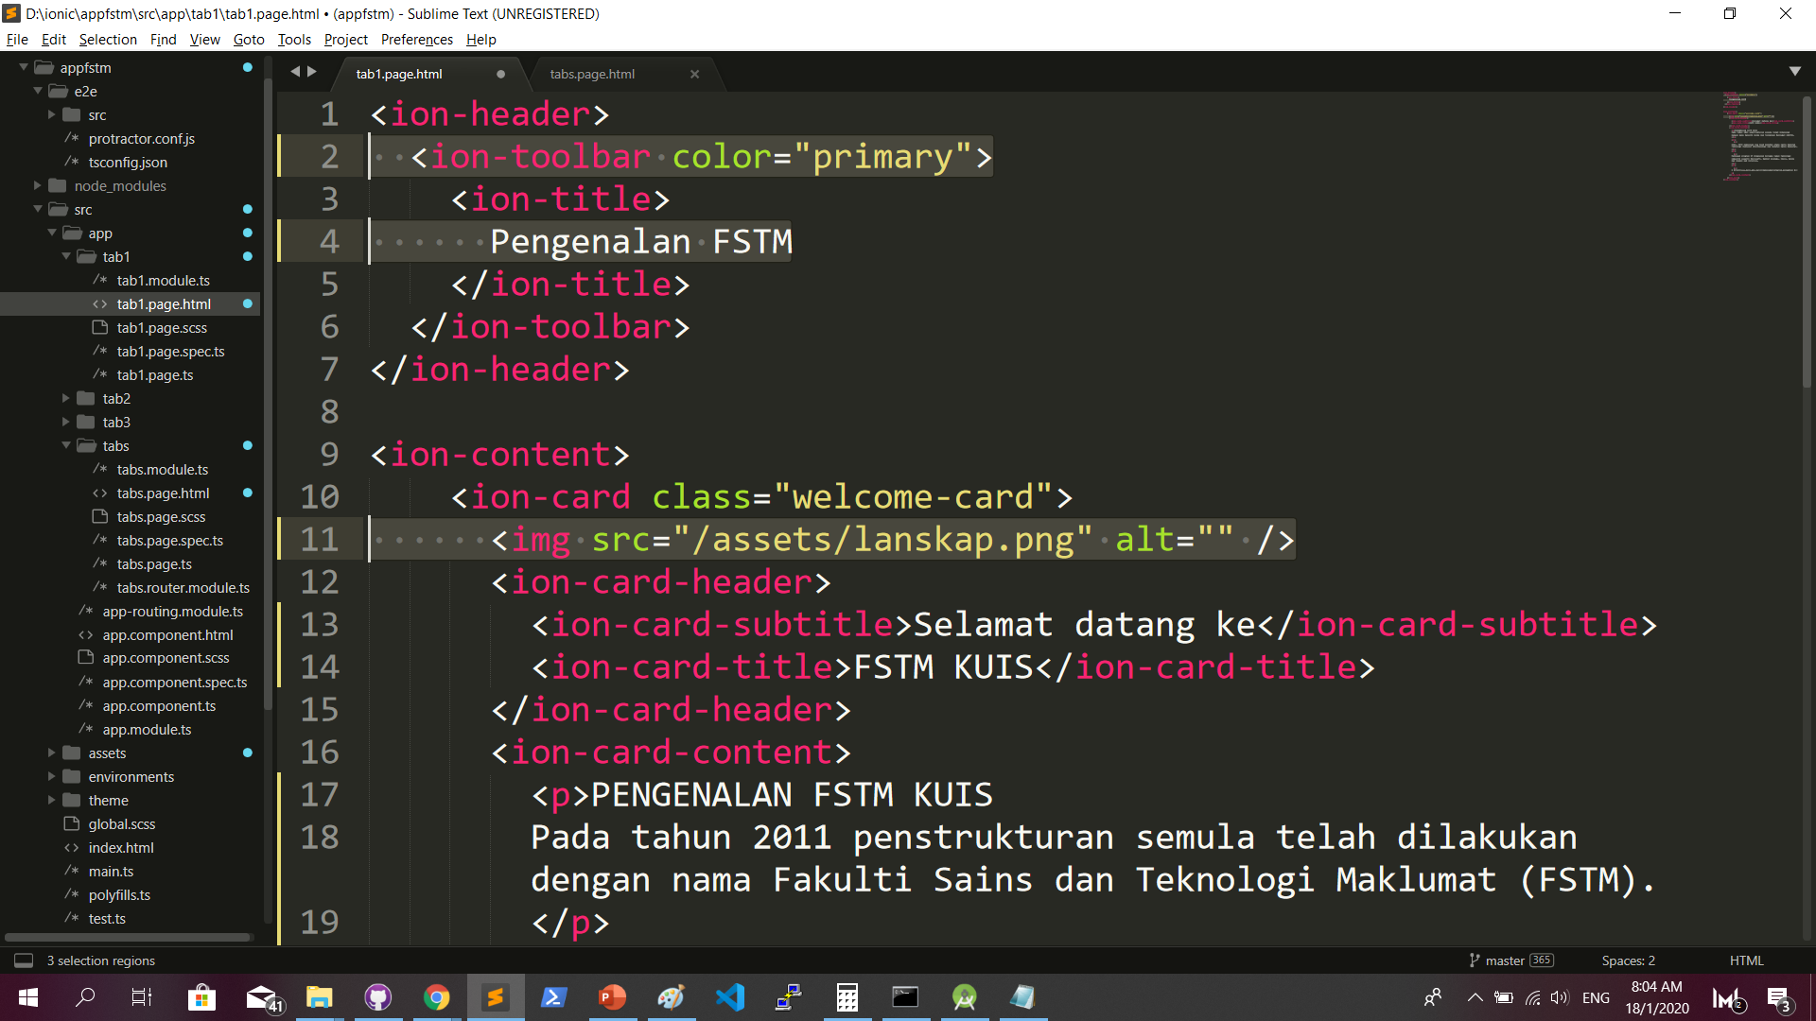
More interface cosmetics: src/app/tab1/tab1.page.html

Slide 45
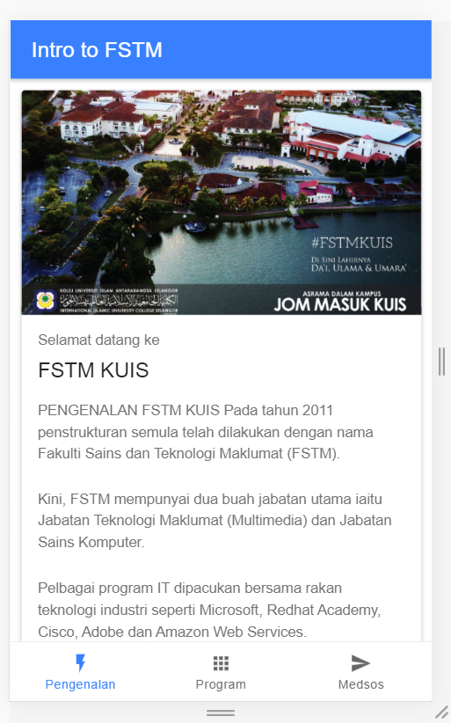
Run ionic serve

Slide 46
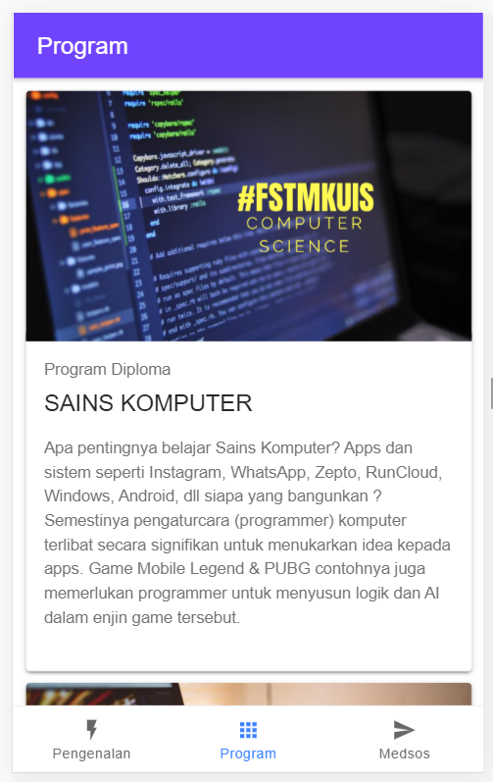
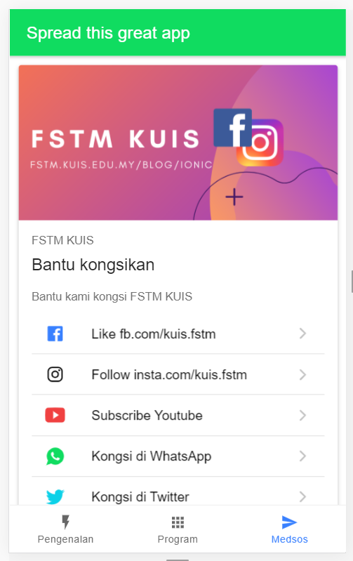
Next tab2 and tab3

Slide 47
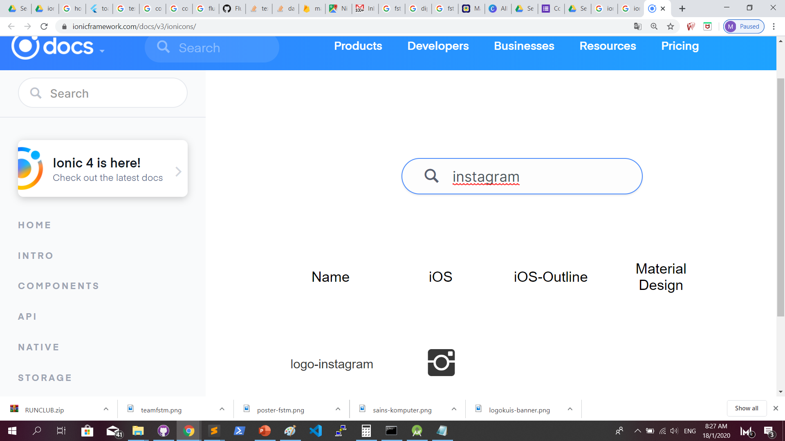
Always refer to documentations: https://ionicframework.com/docs

Slide 48
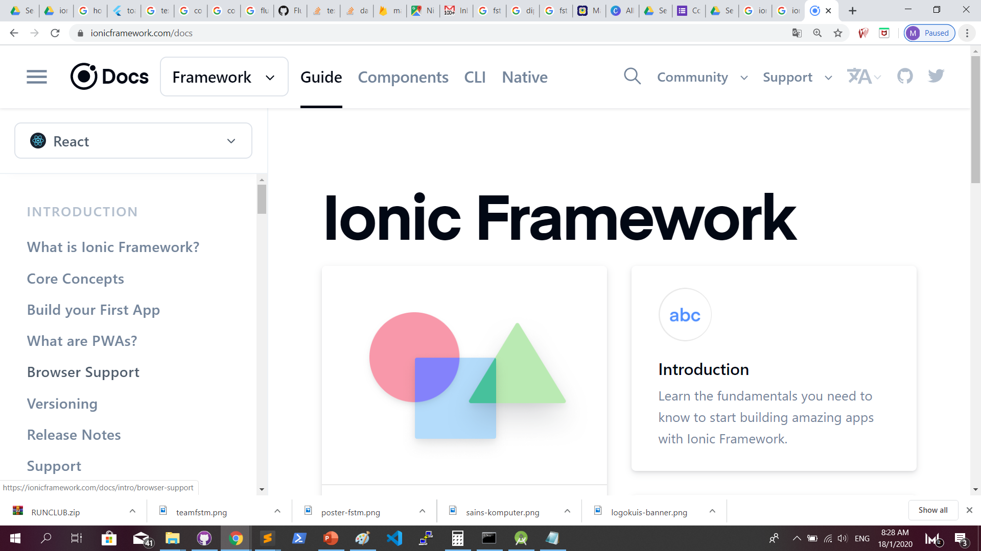
Always refer to documentations: https://ionicframework.com/docs

Slide 49
Try building a button and make an alert
helloWorld(){
alert(“Hello World”)
}
<ion-button (click)=”helloWorld()”> ALERT </ion-button>
In tab1.page.ts
In tab1.page.html

Slide 50
Page Navigation
3 methods

Slide 51
routerLink in HTML
PAGE 1
PAGE 2
See app-routing.module.ts for page name

Slide 52
Exercise : Link to new page
Let’s generate a page
ionic g page info

Slide 53
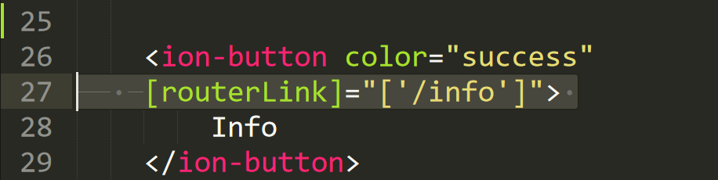
Exercise : Link to new page

Slide 54
NavController in TS
PAGE 1
PAGE 2
See app-routing.module.ts for page name

Slide 55
ModalController
PAGE 1
PAGE 2
Layer on Page 1

Slide 56
Parameters
2 methods

Slide 57
PARAMETERS
PAGE 1
PAGE 2
Name: Kerul
Name: Kerul
Name: Kerul

Slide 58
Using Services,
SEE DAY 2 LESSON
2. Using ActivatedRoute
*CAN SEND OBJECTS
*CANNOT SEND OBJECTS

Slide 59
Using ActivatedRoute
On app-routing.module.ts add param name, example /:id
Add /id when navigating
To get param
import {ActivatedRoute} from ‘@angular/router’
public route:ActivatedRoute
let the_id=this.route.snapshot.params.id

Slide 60
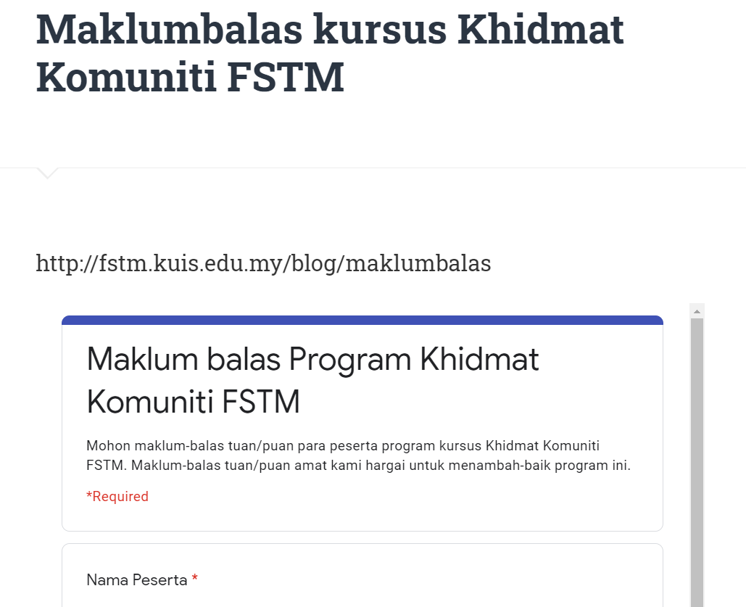
Provide your gmail at http://fstm.kuis.edu.my/blog/maklumbalas/

Slide 61
Deployment: Playstore

Slide 62
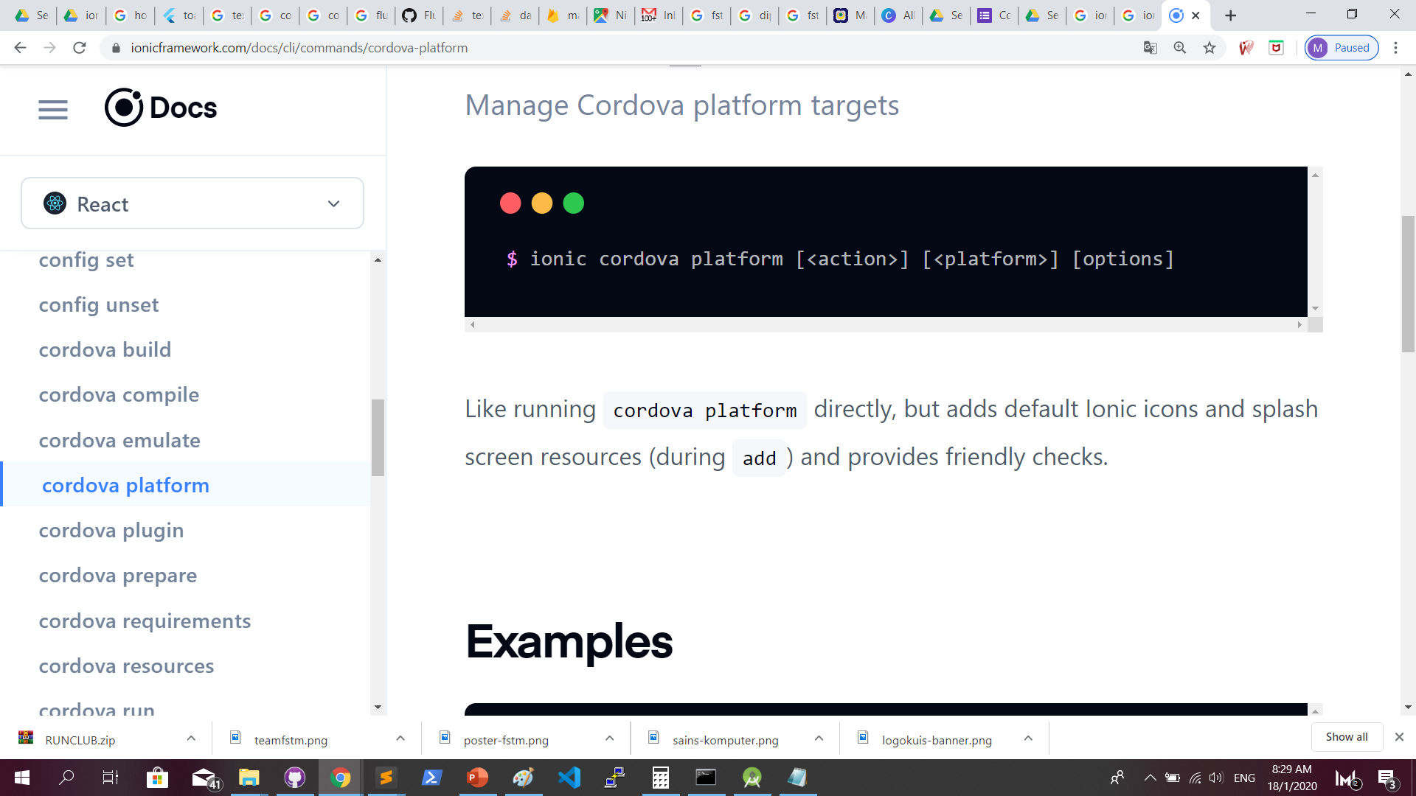
Generate Android platform (docs): https://ionicframework.com/docs/cli/commands/cordova-platform

Slide 63
Generate Android platform
Let’s generate Android platform
ionic cordova platform add android

Slide 64
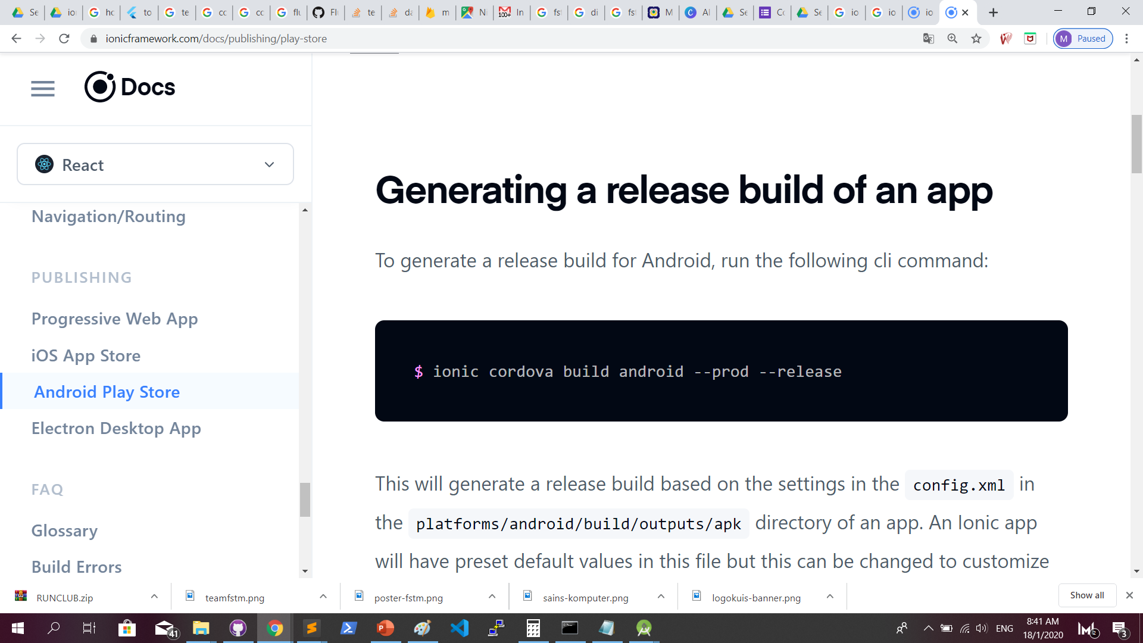
Sign APK : https://ionicframework.com/docs/publishing/play-store

Slide 65
Generate unsigned APK
Locate the unsigned APK in
D:\ionic\appfstm\platforms\android\app\build\outputs\apk\release\app-release-unsigned.apk
And copy to your ionic project directory

Slide 66
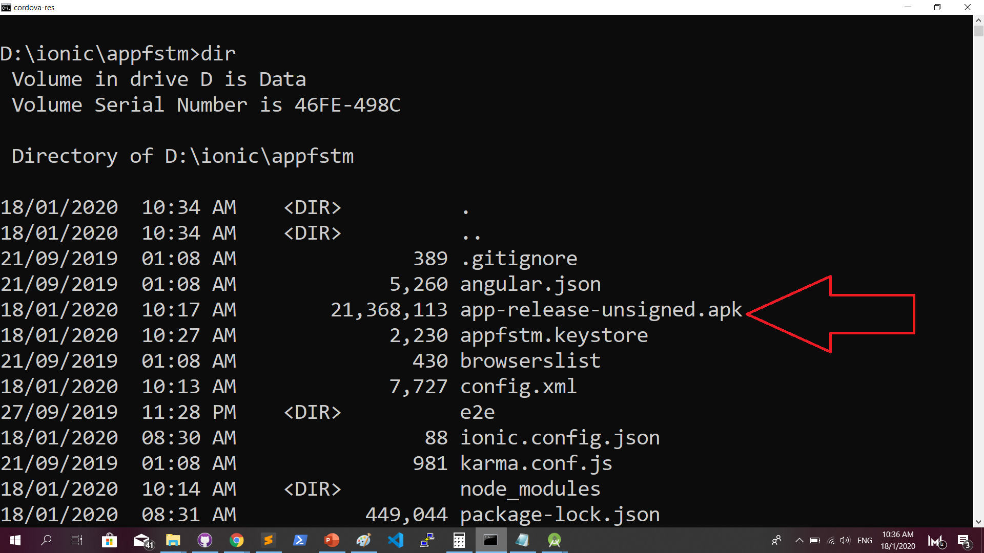
Generate unsigned APK

Slide 67
Generate unsigned APK
ionic cordova build android --prod –release
Output:
BUILD SUCCESSFUL in 1m 53s 42 actionable tasks: 42 executed
Built the following apk(s): D:\ionic\appfstm\platforms\android\app\build\outputs\apk\release\app-release-unsigned.apk

Slide 68
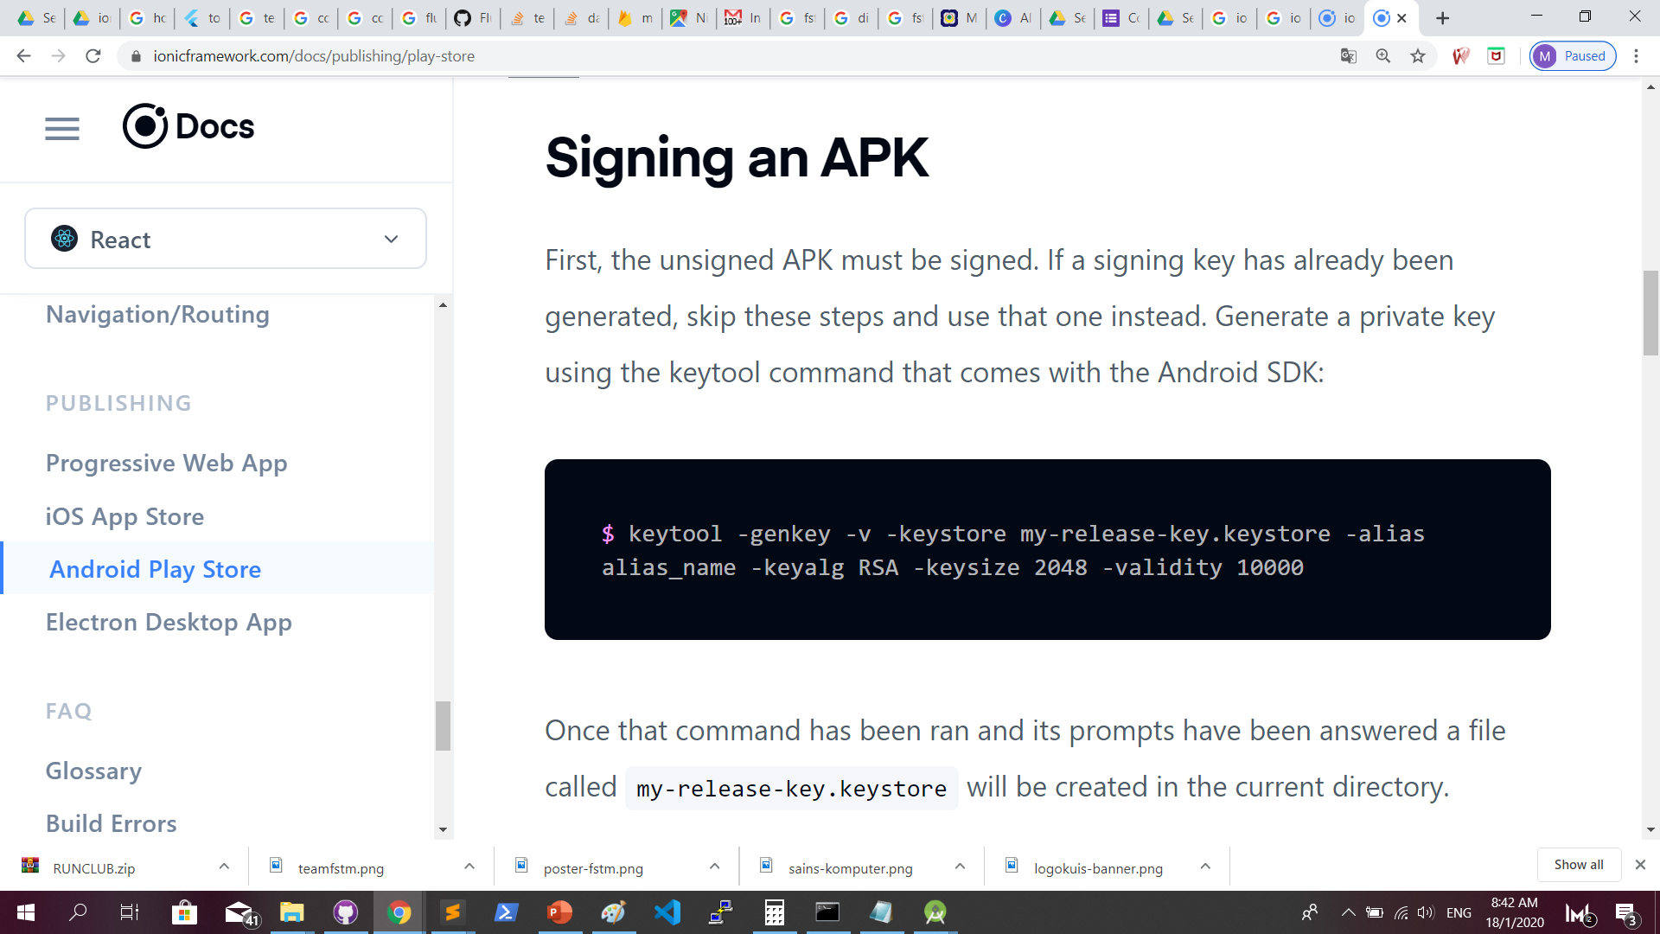
Sign APK : https://ionicframework.com/docs/publishing/play-store

Slide 69
Generate keystore
keytool -genkey -v -keystore appfstm.keystore -alias appfstm -keyalg RSA -keysize 2048 -validity 10000

Slide 70
Generate keystore
Output:
Enter keystore password:
Re-enter new password:
What is your first and last name?
[Unknown]: Kerul Rahman
What is the name of your organizational unit?
[Unknown]: FSTM
What is the name of your organization?
[Unknown]: KUIS
What is the name of your City or Locality?
[Unknown]: Bangi
What is the name of your State or Province?
[Unknown]: Selangor
What is the two-letter country code for this unit?
[Unknown]: 60
Is CN=Kerul Rahman, OU=FSTM, O=KUIS, L=Bangi, ST=Selangor, C=60 correct?
[no]: yes
Generating 2,048 bit RSA key pair and self-signed certificate (SHA256withRSA) with a validity of 10,000 days
for: CN=Kerul Rahman, OU=FSTM, O=KUIS, L=Bangi, ST=Selangor, C=60
Enter key password for <appfstm>
(RETURN if same as keystore password):
Re-enter new password:
[Storing appfstm.keystore]

Slide 71
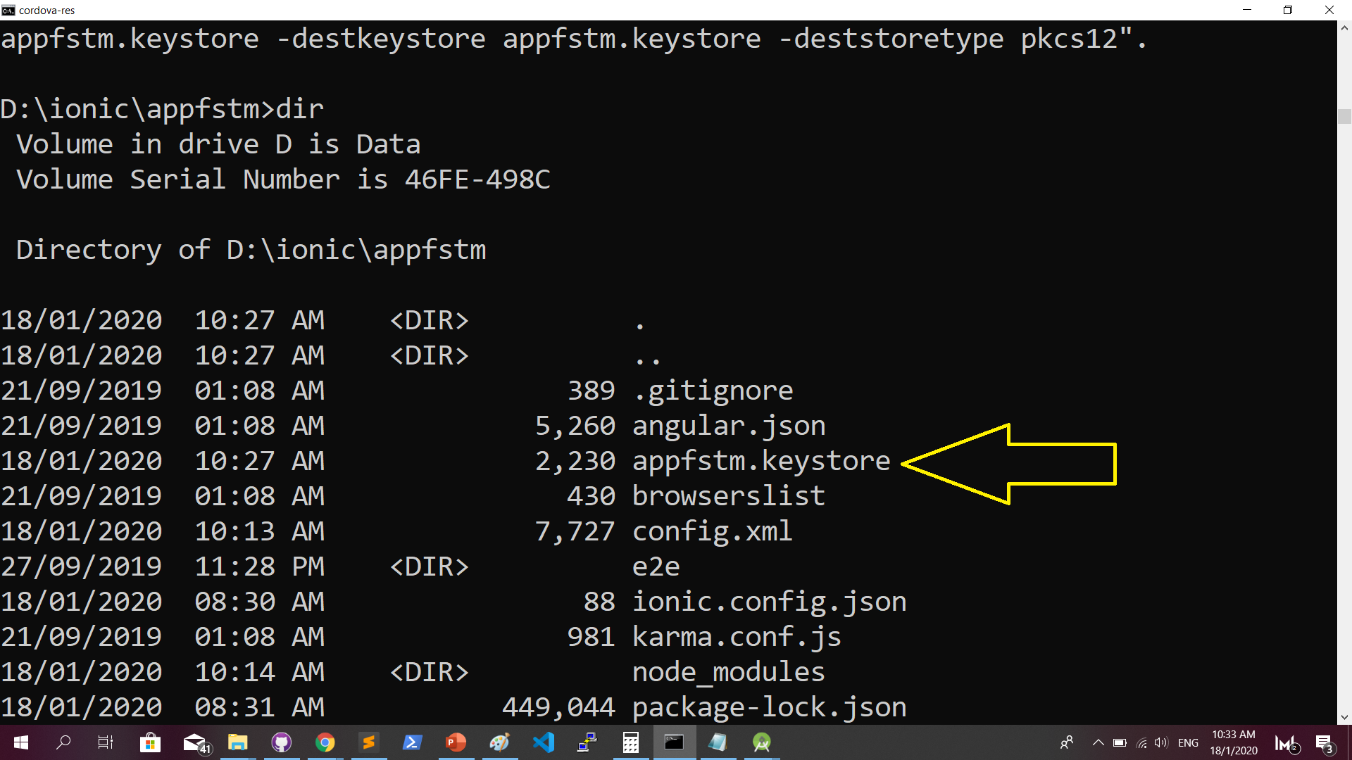
Generate keystore
Output:

Slide 72
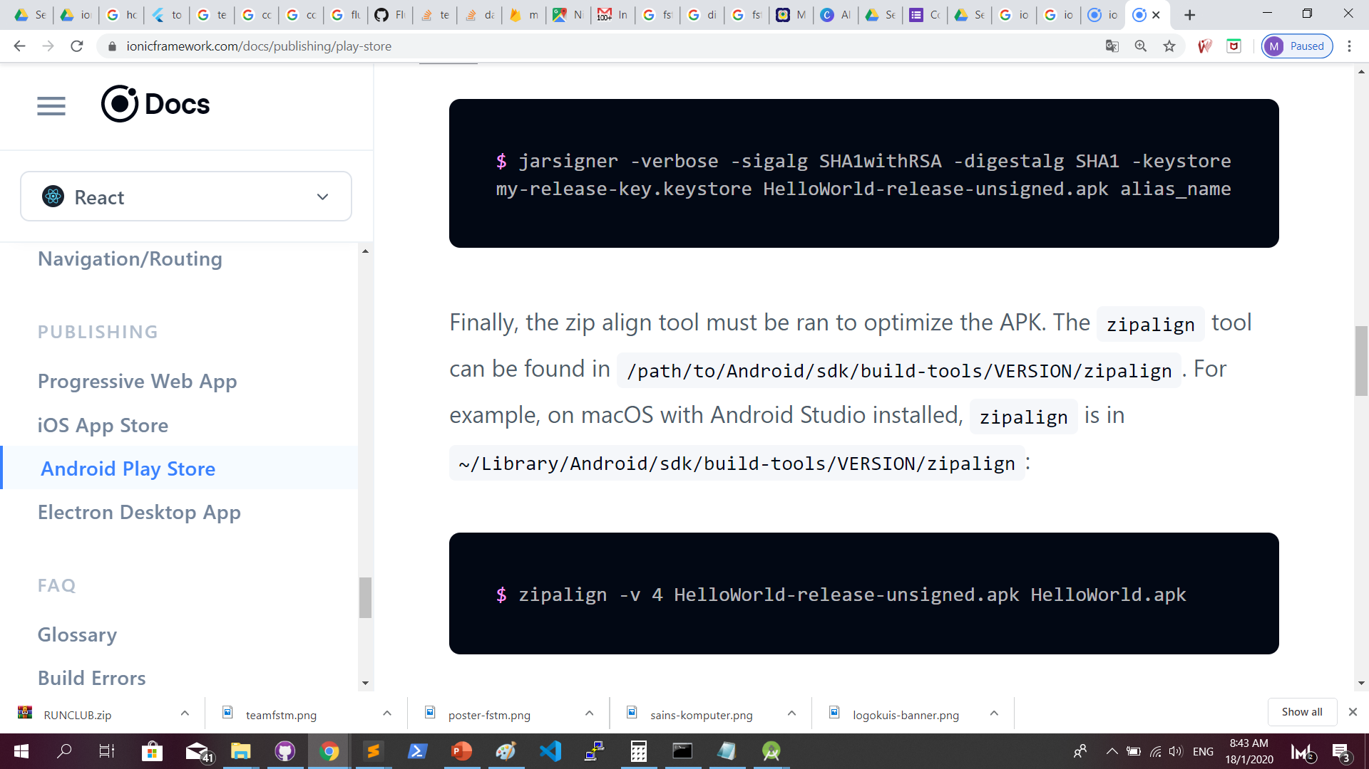
Sign APK : https://ionicframework.com/docs/publishing/play-store

Slide 73
Jarsigner
jarsigner -verbose -sigalg SHA1withRSA -digestalg SHA1 -keystore appfstm.keystore app-release-unsigned.apk appfstm

Slide 74
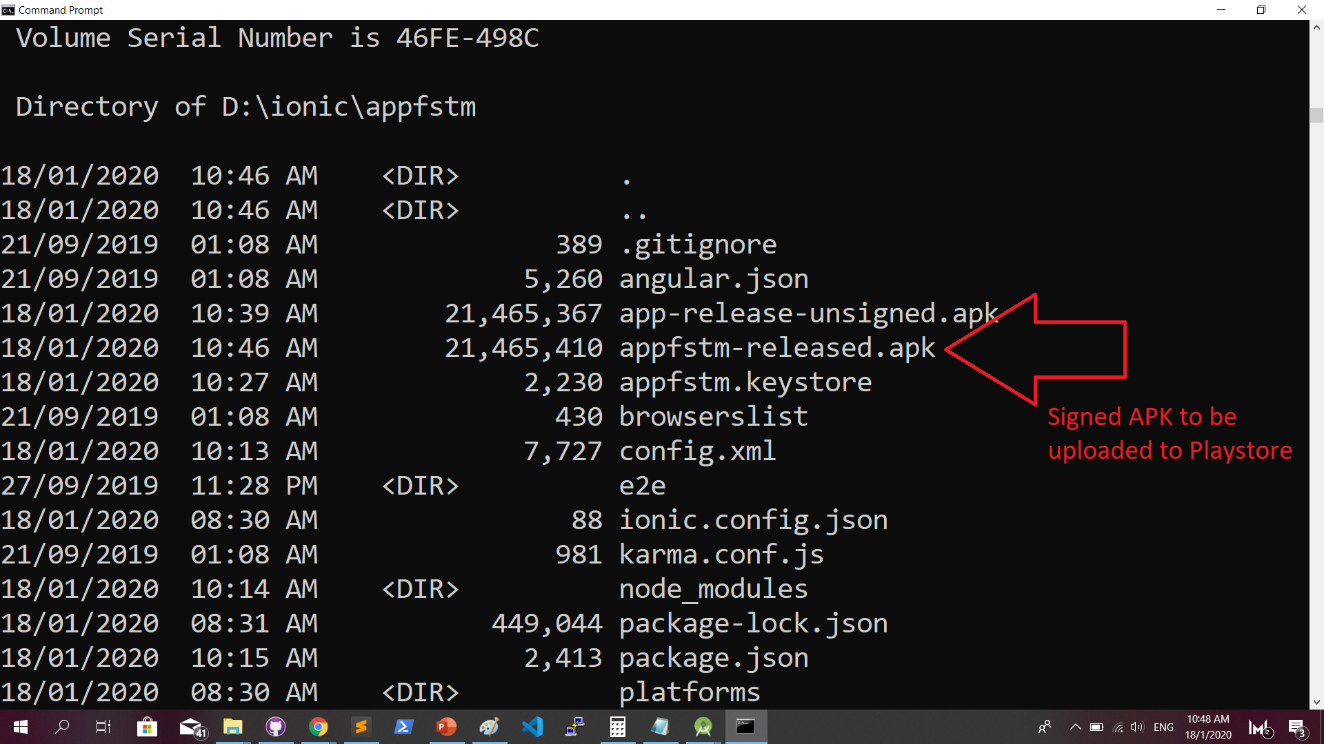
Zipalign
zipalign -v 4 app-release-unsigned.apk appfstm-released.apk

Slide 75
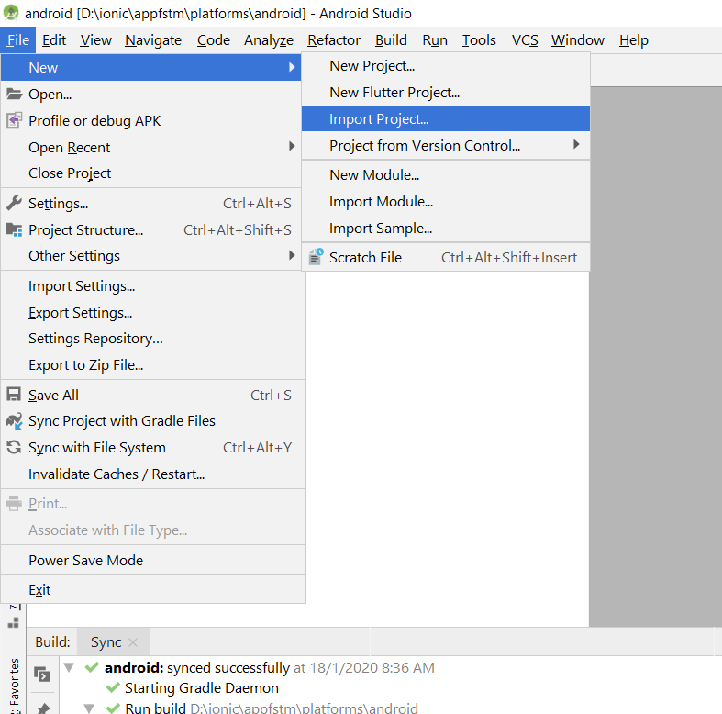
Optionally: Import to Android Studio
Import project

Slide 76
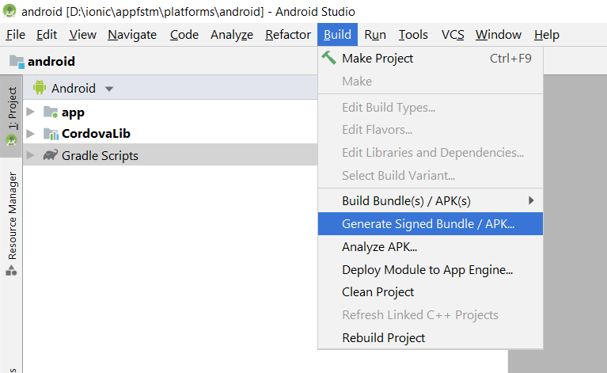
Using Android Studio to generate Sign APK

Slide 77

Play.google.com
Register for a developer ID
USD25 for life.
Another consideration: you need to pay through Google Wallet, using a credit card. https://play.google.com/apps/publish/

Slide 78
Graphic Materials
high-res icon. (size 512px x 512px)
Featured graphic. (size 1024px x 500px)
at least 2 non-Android TV screenshots. (2 screenshot images. Min length for any side: 320px)

Slide 79
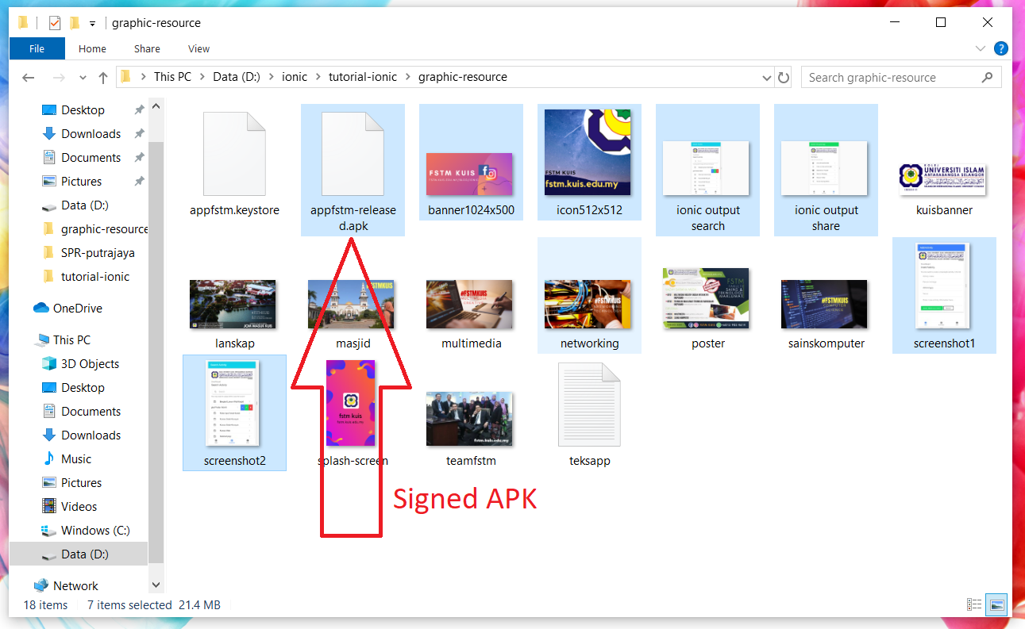
Graphic materials & signed APK

Slide 80
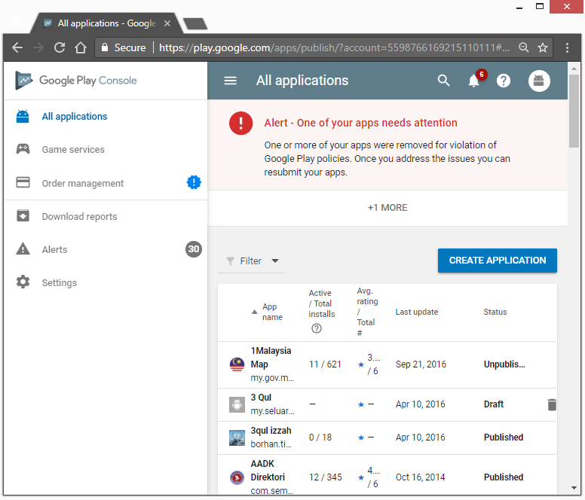
Create Application

Slide 81
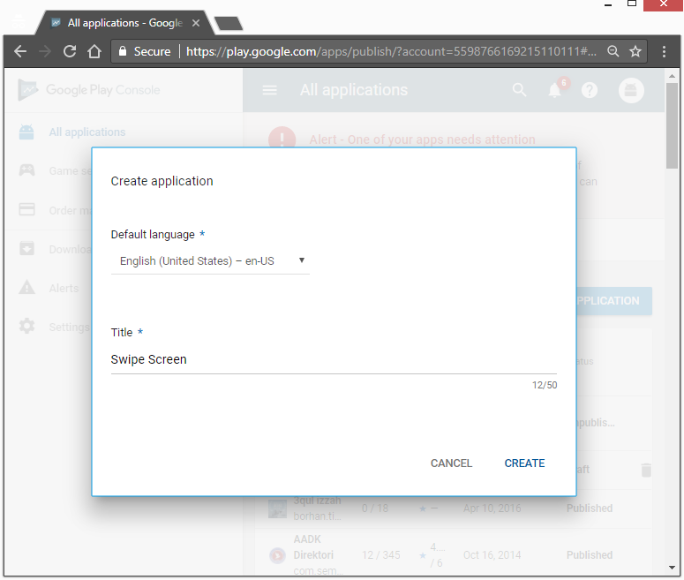

Slide 82
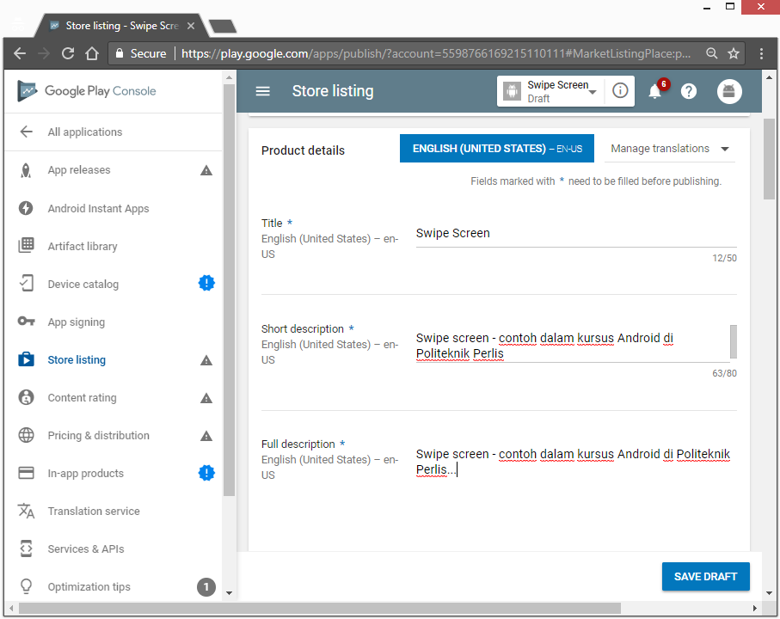
App Description

Slide 83
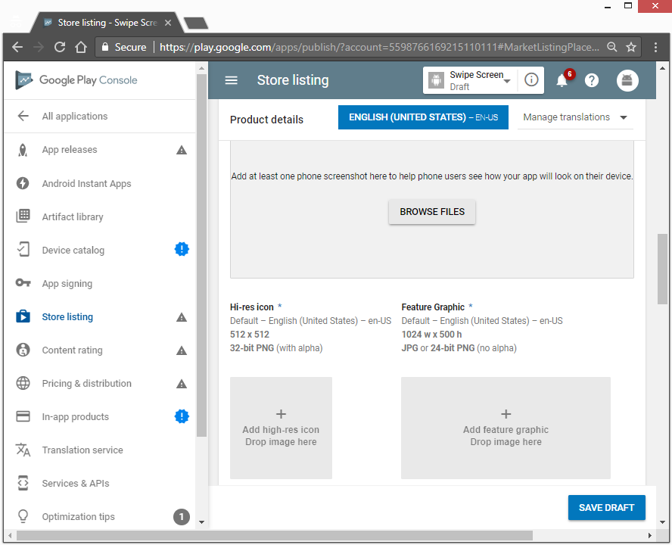
Upload graphic Assets

Slide 84
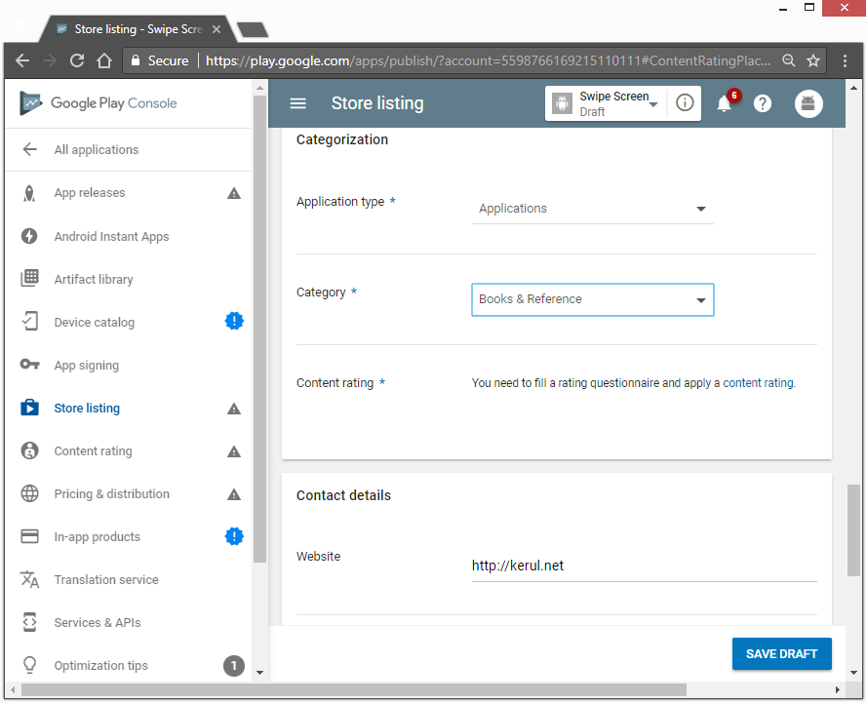
App Category

Slide 85
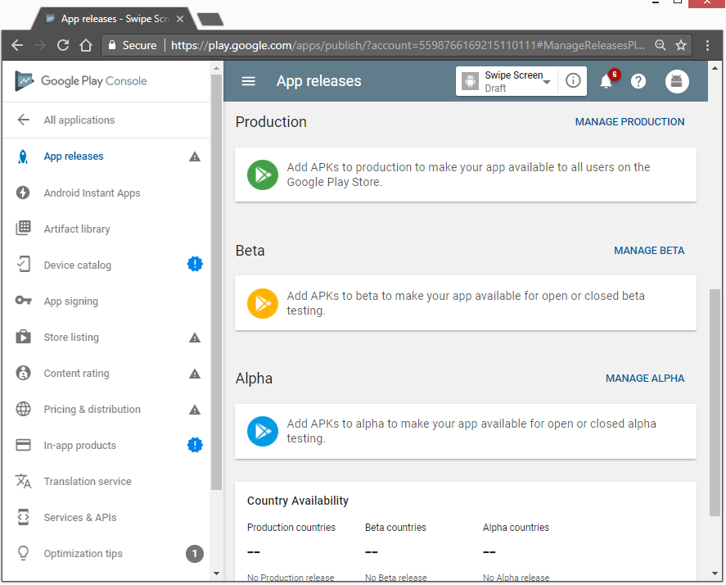
Upload APK

Slide 86
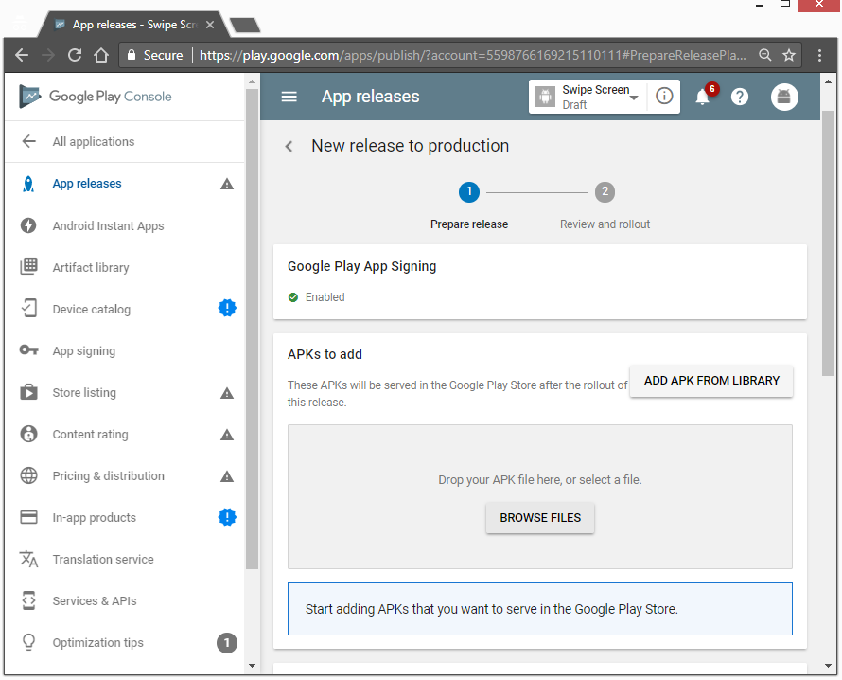
Upload APK

Slide 87
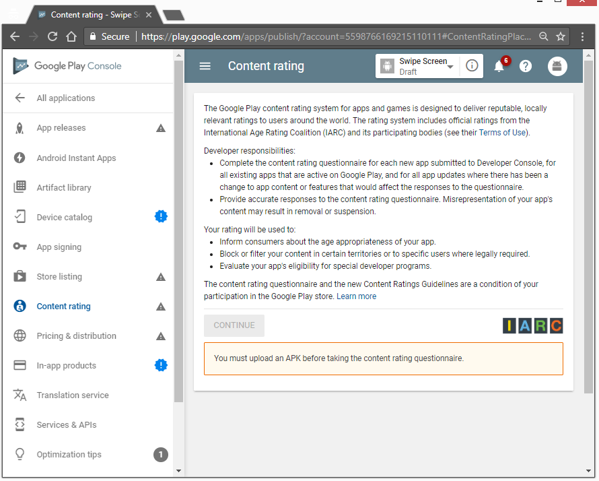
Content Rating

Slide 88
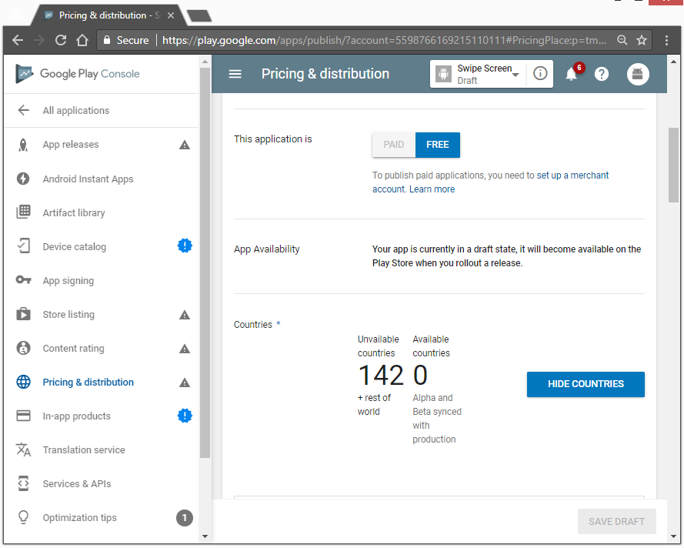
Pricing

